Slide 1
C37FF Finance
Internal Rate of Return

Slide 2
Internal rate of return – more than one future cash flow
The ‘simple’ formula for % return can only work for one and only one future cash flow.
It is worth emphasising this point, as what we are about to do is complicated and not terribly intuitive
Keep in mind that we are still trying to find x% return, but for an investment project with many future cash flows

Slide 3
The Rule for IRR
To find the IRR, we find the rate of return which makes the NPV=0
Why does this work?
Consider the equation
FV_{n} = (1 + r)^{n} × PV
That is the future value is the result of applying compound interest to a present value

Slide 4
The Rule for IRR
The previous equation finds FV_{n} by inputting the known values of PV and r
However, suppose we already knew PV and FV_{n}. What we don’t know is r
One way of solving for r is as follows – Next Slide

Slide 5
The Rule for IRR
FV_{n} /(1 + r)^{n} – PV = 0
In other words, Discounted future cash flow minus present value, i.e. NPV, equals zero.
Thus we solve for r using this approach.
If you don’t understand the algebra, just focus on the rule.
The % return for any cash flow is the discount rate which makes NPV = 0

Slide 6
Finding the Zero Point
We know that £100 with 10% interest becomes 110 over one period.
110/1.1-100 = 0
110/1.11-100 = -0.9
110/1.09-100 = 0.92
11% is too high and produces –NPV
9% is too low and produces +NPV
The correct answer is 10% which yields 0 NPV

Slide 7
Finding the Zero Point
We know that £100 with 10% interest becomes 121 over two periods. Suppose we didn’t?
Try 11%
121/(1.11)²-100 = -1.79 (+NPV 11% r too high)
Try 9%
121/(1.09)-100 = 1.84 (-NPV 9% r too low)

Slide 8
Finding the Zero Point
You may remember that for the Trattoria project
NPV at 10% was -£10,461
NPV at 5% was +16,474
So what can you say about where the IRR is likely to be?
Learning Activity – Find the NPV for a % rate between 5 and 10. Are you any closer to IRR, where NPV = 0?

Slide 9
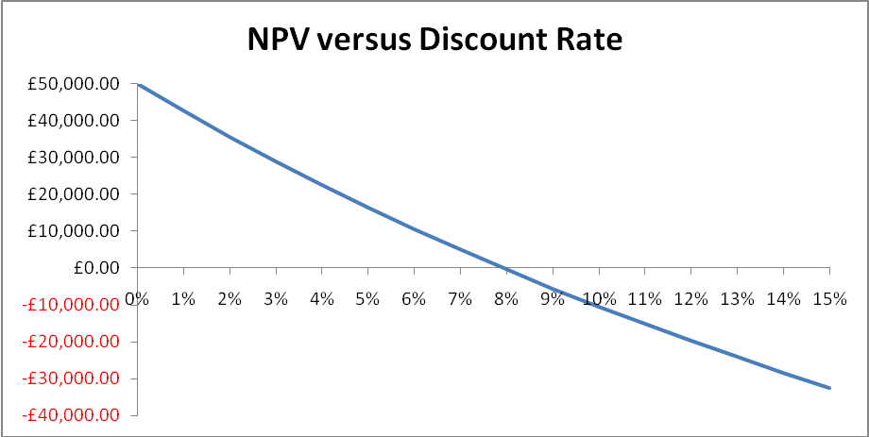
NPV versus discount rate
IRR where NPV = 0
(In this case, IRR = 8%)
The IRR is where NPV equals zero.

Slide 10
Trial and Error
In other words, we take a guess at what %, r (IRR) is
If NPV remains positive (£16,474), our guess was too low (5%).
If NPV becomes negative (-£10,461), our guess was too high (10%)

Slide 11
Trial and Error
Trial and error is not recommended as a technique.
However, if you set up a discounted cashflow on a spreadsheet and watch the result of varying the discount rate, it will give you a feel for the underlying logic.
We can do this with the cashflow -100 in year 0, 121 in year 2 to watch it converge to 10%

Slide 12
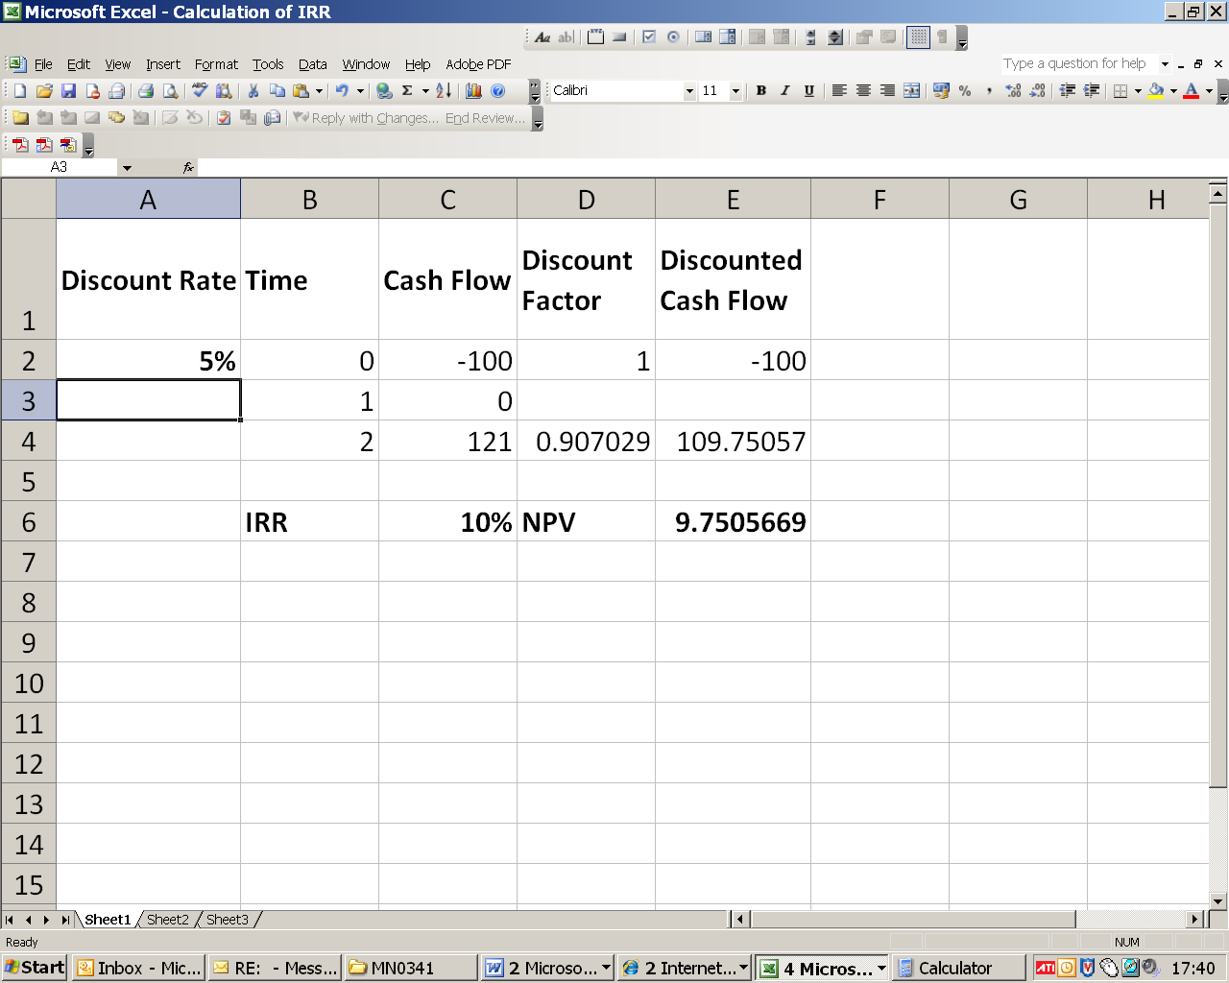
Finding the internal rate of return – Trial and Error
We know that the IRR of this project is 10%.
Therefore a 5% discount rate will give a positive NPV.

Slide 13

Finding the internal rate of return – Trial and Error
We know that the IRR of this project is 10%.
Therefore a 20% discount rate will give a negative NPV.

Slide 14
The Discount Factor
Note – In the following slides I have multiplied by the discount factor
To me, it is more intuitively obvious just to divide by the interest multiple.
But it is common practice to multiply by the discount factor.
The discount factor is just one divided by the interest multiple.

Slide 15
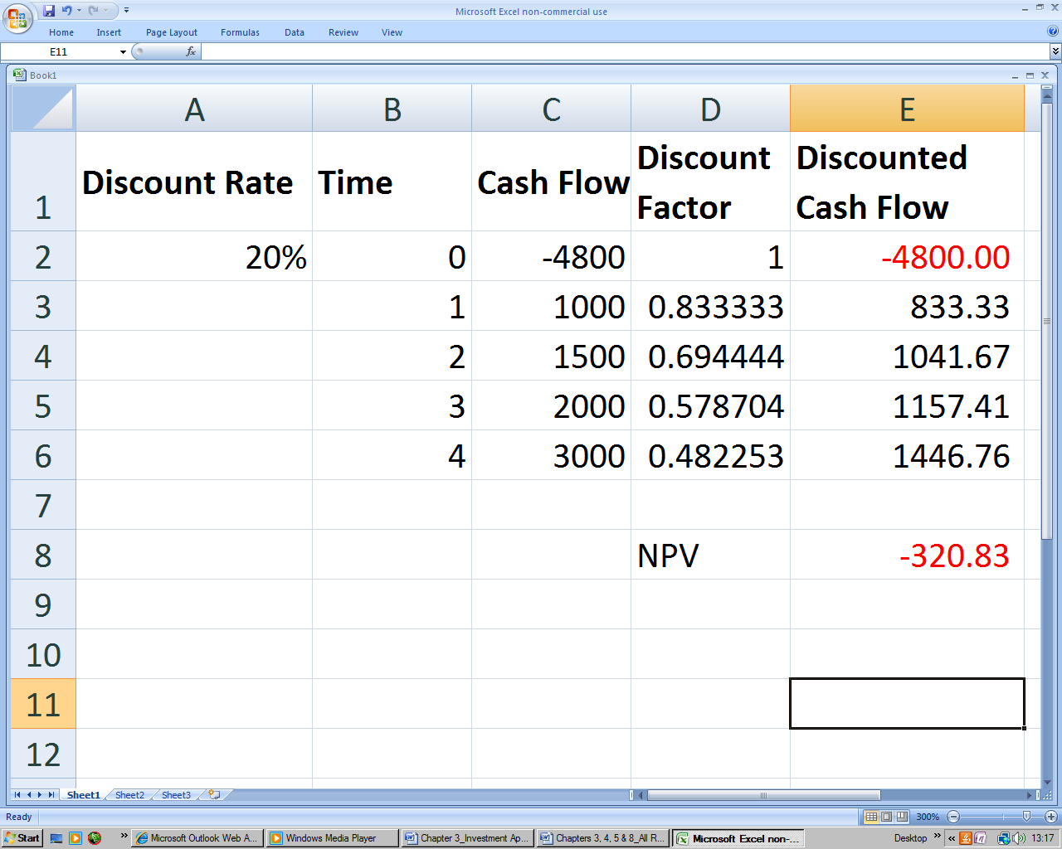
Linear Interpolation for IRR – try 20%
The trial and error approach can be systemised as linear interpolation. We take two guesses at the IRR.
The first guess for r is higher than the true value and makes NPV negative.
We might call these r^{negative} and NPV^{negative}.

Slide 16
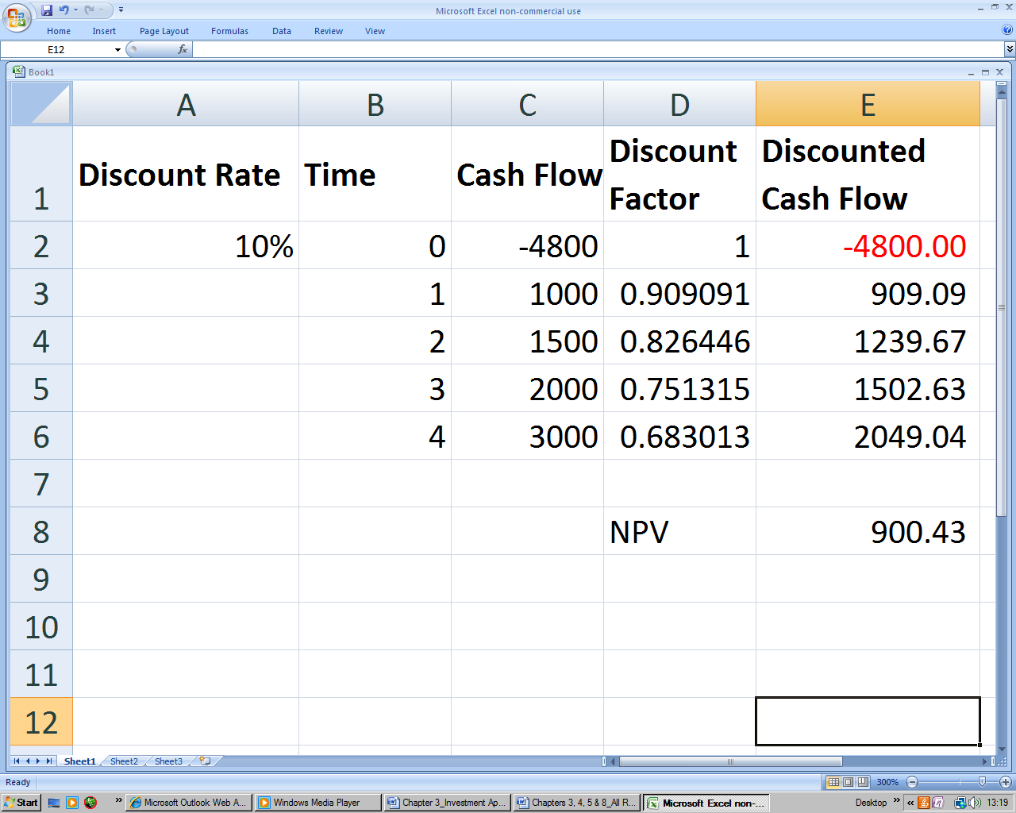
Linear Interpolation for IRR – try 10%
The second guess at the IRR (or r) is lower than the actual value and makes NPV positive.
We might call these r^{positive} and NPV^{positive}

Slide 17
Learning Activity
Calculate the discount factors for r=10% over 1 and 2 years

Slide 18
Finding the internal rate of return – Trial and Error
Linear interpolation formula
IRR = r^{positive} + (Ratio)× ( r^{negative} – r^{positive})
Ratio =(NPV^{positive}/(NPV^{positive}- – NPV^{negative}))

Slide 19
Finding the internal rate of return – Trial and Error
e.g. For the example above;
10% + (Ratio)×(20% – 10%)
= 10% + (900.43/(900.43 + 320.83))×10%
= 10% + 0.737×10% = 17.37%.

Slide 20
IRR, The Decision Rule
Decision Rule If IRR ≥ k, (where k is the cost of capital) then accept the project. Otherwise reject.
Note that k is expressed as a percentage. i.e. It is the overall return on capital required by investors.
If capital is rationed, then rank projects by IRR

Slide 21
Problems with the IRR (1)
More than one change in cash flow sign from negative to positive can make the underlying problem to be solved highly non-linear.
This in turn can lead to more than one root.
That is,
  More than one solution for the rate of discount which makes the NPV equal zero.
  This makes no sense and IRR cannot be used.
Situation is illustrated in next slide.

Slide 22
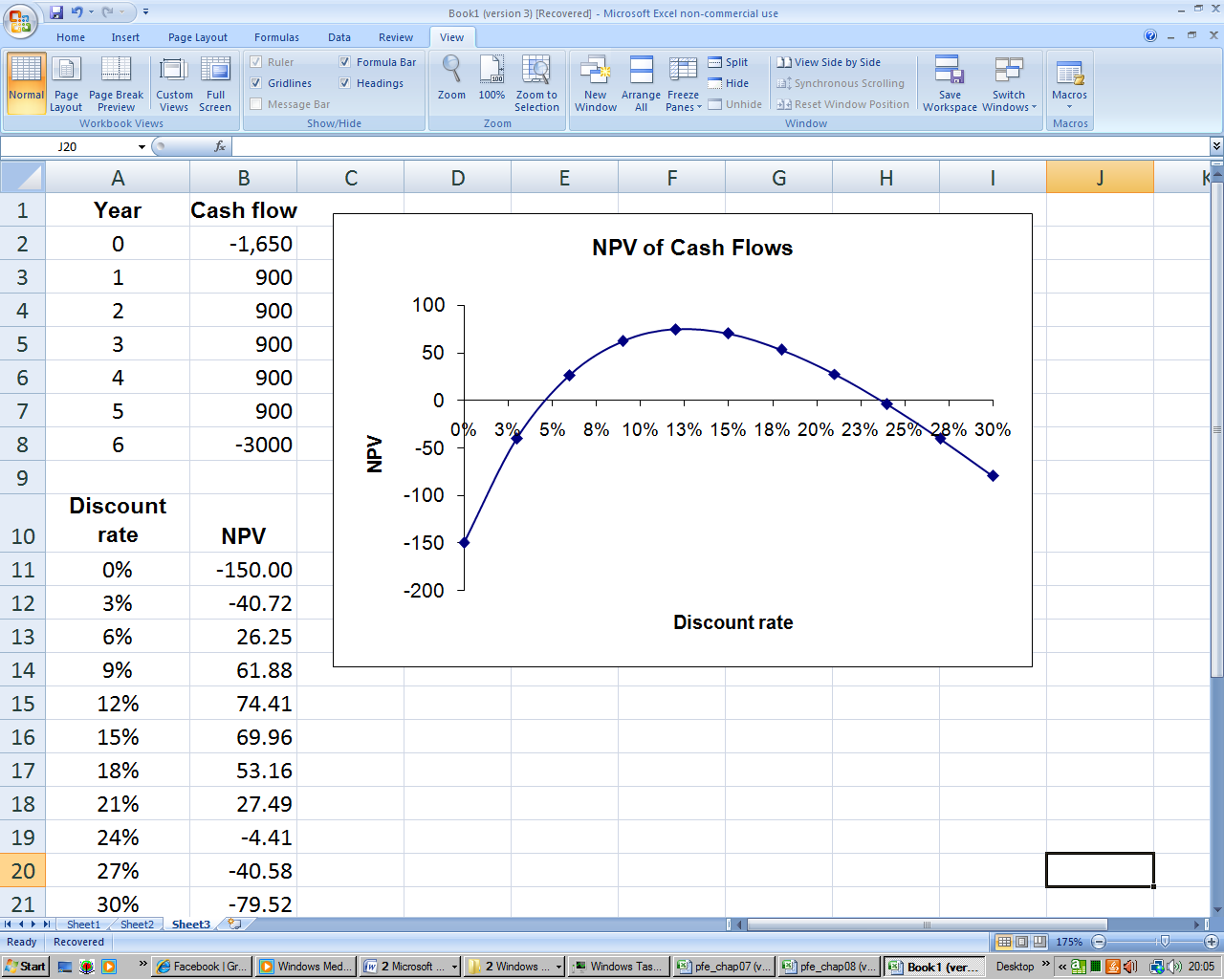
Unconventional cash flow
This is an unconventional cash flow with additional investment required at the end.
There are now two IRRs – a nonsensical result.

Slide 23
Problems with IRR (2)
Reinvestment assumption of the IRR
Recall that IRR is based on technique of finding rate of return where NPV is zero
It is possible to show that this is mathematically equivalent to the implicit assumption that all intermediate cashflows can be reinvested at the IRR.

Slide 24
Learning Activity
In the Trattoria Project, multiply the initial £200K investment in year 0 by 1.08^5 to bring it forward to year 5.
Then do the same for the positive cash flows.
Eg 50K in year 1, multiplied by 1.08^4
Eg 50K in year 2, multiplied by 1.08^3 etc
When you add up the future CF, they should be roughly equal to the initial investment

Slide 25
Problems with IRR (3)
IRRs can’t be added to get a sum total of the contribution to value of all projects. This is by contrast with NPV which can.

Slide 26
Problems with IRR (4)
The NPV versus Discount Rate schedule for two different projects may crossover. In this case NPV and IRR can conflict in terms of decision making criteria.

Slide 27
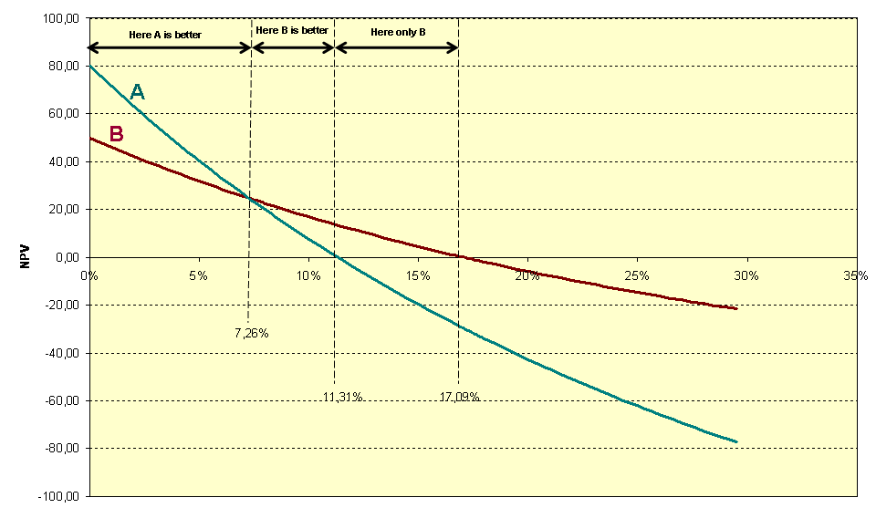

Slide 28
Problems with IRR (5 and 6)
5. The larger the range for linear interpolation, the greater the deviation from the true underlying IRR.
6. A % tells you nothing about the relative contribution of the project in terms of cash.

